Slide 1
Java Web Development basis
-from Servlet To JSP
First09 Chapter Use EL versusJSTL

Slide 2
learning target:
Understand the expression language (EL)advantage
Grasp EL Basic grammar
Grasp EL Operator application
Master how to use ELConditionally evaluate expressions
Grasp EL Scope related 4 Implicit objects
Grasp EL in ".“ Operator and "[]“ Operator usage
Master how to use EL access JavaBean Attribute of
Grasp JSTLprocess control tags in
Grasp JSTL in <c:forEach> </c:forEach>

Slide 3
9.1 EL(Expression language) use
9.1.1 ELOverview and basic grammar
EL(Expression Language)
  ELIt's called an expression language.
aim of design
  Simplify page output
ELGrammar
  To$Symbol starts, the code is written in{}between. E.g:
  ${A calculated expression}

Slide 4
9.1.2 ELOutput the value of constants and variables
Output constant
<html>
<head>
<meta http-equiv="Content-Type" content="text/html; charset=UTF-8">
<title>JSP Page</title>
</head>
<body>
  ${"Hello World!"}
</body>
</html>

Slide 5
Output variable
<html>
<head>
<meta http-equiv="Content-Type" content="text/html; charset=UTF-8">
<title>JSP Page</title>
</head>
<body>
<%
  String s="Hello World!";
  request.setAttribute("msg", s);
%>
  ${msg}
</body>
</html>

Slide 6
ELIt can also be written directly inHTMLThe inside of the tag can also be written in the attribute of a tag, for example:
<%
  String s="index.jsp";
  request.setAttribute("url", s);
%>
<a href="${url}">This is a hyperlink to the homepage</a>
Actual output:
<a href="index.jsp">This is a hyperlink to the homepage</a>

Slide 7
9.1.3 EL Operator
In EL Arithmetic operations, logical operations, and relational operations can be performed in it. In particular, there is also the null operator (empty)

Slide 8
Arithmetic Operator
Arithmetic operators have addition (+), subtraction (-),multiplication(*),division(/ordiv), take the remainder (%ormod). Usage is roughly the same as in other languages.
ELexpression | result
${1} | 1
${1 + 2} | 3
${1.2 + 2.3} | 3.5
${1.2E4 + 1.4} | 120001.4
${-4-2} | -6
${21 * 2} | 42
${3/4}or${3 div 4} | 0.75
${3/0} | Infinity
${10%4}or${10 mod 4} | 2
${(1==2)? 3: 4} | 4

Slide 9
Logical Operators
The logical operators are AND (&&orand),or(||oror),non(not) Three kinds. versusJavaThe same in the language.
ELexpression | result
${true and false}or${true && false} | false
${true or false}or${true || false} | true
${not true}or${! true} | false

Slide 10
Relational operator
The relational operator has less than (<orlt),more than the(>orgt),greater or equal to(>=orge), less than or equal to (<=orle),equal(==oreq),not equal to(!=orne).
ELexpression | result
${1 <2} or ${1 lt 2} | true
${1> (4/2)} or ${1 gt (4/2)} | false
${4.0 >= 3} or ${4.0 ge 3} | true
${4 <= 3} or ${4 le 3} | false
${100.0 == 100} or ${100.0 eq 100} | true
${(10*10) != 100} or ${(10*10) ne 100} | false
${'a' <'b'} | true
${"hip"> "hit"} | false
${'4'> 3} | true

Slide 11
Null operator
Null operator (empty) Is used to determine whether the parameter isnull, Empty string, empty array, emptyMapOr empty collection, if yes then returntrue, Otherwise returnfalse
ELexpression | result
${empty null} | true
${empty ""} | true

Slide 12
9.1.4 EL Implied objects related to scope
EL Provides a series of implicit objects, including 4 related to the scope, and the object is the mapping type (Map),able to passkey-valueAccess to the form.
Implied variable name | Types of | effect
pageScope | java.util.Map | You can find the value corresponding to an attribute name in the page range
requestScope | java.util.Map | The value corresponding to a certain attribute name can be found in the request scope
sessionScope | java.util.Map | The value corresponding to a certain attribute name can be found in the scope of the session
applicationScope | java.util.Map | You can find the value corresponding to a certain attribute name in the scope of application

Slide 13
9.1.5 EL middle"."Operator and "[]“ Operator
ELTwo operators are provided, namely "."Operator and "[]"Operator. You can take out the objects in the scope.
Goal: Learn"."Operator and "[]"Operator
Construction name:Example0901
Files used: (see next page)

Slide 14
file name | Description
Person.java | And the first8The same as in the example at the end of the chapter, manually createdJavaBean, EncapsulatedPersonInformation, there areid,name,pwd,gender4Fields and corresponding access control methods
EL1.jsp | Manually createdJSPFile, use "."Operator outputMapType object information.
EL2.jsp | Manually createdJSPFile, use "."Operator outputJavaBeanType object information
EL3.jsp | Manually createdJSPFile, use "[]"Operator outputMapType object information.
EL4.jsp | Manually createdJSPFile, use "[]"Operator outputJavaBeanType object information.
EL5.jsp | Manually createdJSPFile, use "[]"The operator outputs the information of the array type object.
EL6.jsp | Manually createdJSPFile, use "[]"Operator outputListType object information.

Slide 15
"."Operator
"."The operation object of the operator is mainly the mapping type (Map)withJavaBeanType, for the mapping type (Map), which can be accessed in the form of key-value; forJavaBeanType, which can be accessed in the form of attribute name.
EL1.jspDemonstrates how to use "."Operator outputMapType object information.
EL2.jspDemonstrates how to use "."Operator outputJavaBeanType object information.
The objects operated on are stored inrequestDomain.

Slide 16
EL1.jsp
<body>
<h1>use"."Operator outputMapType object information</h1>
  <%
    HashMap fruitMap = new HashMap();
    fruitMap.put("f1", "banana");
    fruitMap.put("f2", "apple");
    fruitMap.put("f3", "cantaloupe");
    request.setAttribute("fmap", fruitMap);
  %>
  First1Growing fruits:${requestScope.fmap.f1}<hr/>
  First2Growing fruits:${requestScope.fmap.f2}<hr/>
  First3Growing fruits:${requestScope.fmap.f3}<hr/>
  All fruits:${requestScope.fmap}
</body>

Slide 17
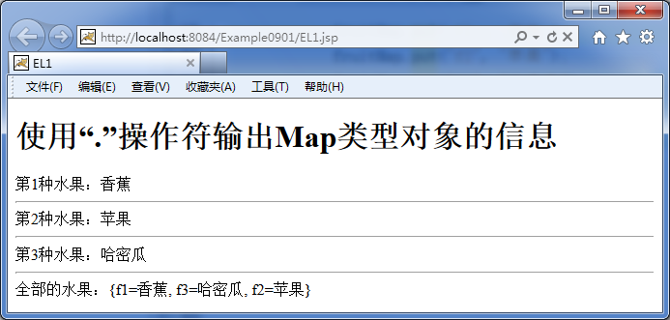
use"."Operator outputMapType object information

Slide 18
EL2.jsp
<body>
  <h1>use"."Operator outputJavaBeanType object information</h1>
  <jsp:useBean id="p" class="cn.edu.djtu.vo.Person" scope="request"/>
  <jsp:setProperty name="p" property="id" value="001"/>
  <jsp:setProperty name="p" property="name" value="Zhang San"/>
  <jsp:setProperty name="p" property="pwd" value="111111"/>
  <jsp:setProperty name="p" property="gender" value="male"/>
  id:${requestScope.p.id}<hr/>
  name:${requestScope.p.name}<hr/>
  pwd:${requestScope.p.pwd}<hr/>
  gender:${requestScope.p.gender}<hr/>
  Export the object?${requestScope.p}
</body>

Slide 19
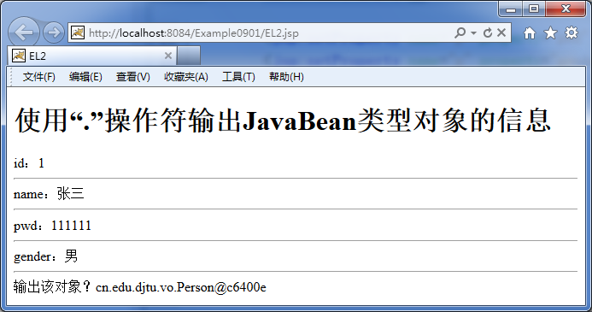
use"."Operator outputJavaBeanType object information

Slide 20
"[]"Operator
If the object removed from the scope is not a mapped type (Map) Or notJavaBeanType, you need to use "[]"Operator processing.
"[]"Operators can handle:
Mapping type (Map) Object (EL3.jsp)
JavaBeanType object (EL4.jsp)
Array type object (EL5.jsp)
List type (List) Object (EL6.jsp)

Slide 21
EL3.jsp
<body>
<h1>use"[]"Operator outputMapType object information</h1>
<%
  HashMap fruitMap = new HashMap();
  fruitMap.put("f1", "banana");
  fruitMap.put("f2", "apple");
  fruitMap.put("f3", "cantaloupe");
  request.setAttribute("fmap", fruitMap);
%>
  First1Growing fruits:${requestScope.fmap["f1"]}<hr/>
  First2Growing fruits:${requestScope.fmap["f2"]}<hr/>
  First3Growing fruits:${requestScope.fmap["f3"]}<hr/>
  All fruits:${requestScope.fmap}
</body>

Slide 22
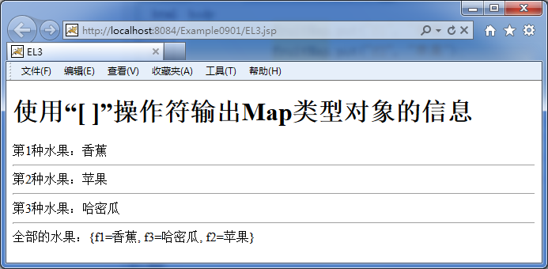
use"[]"Operator outputMapType object information

Slide 23
EL4.jsp
<body>
<h1>use"[]"Operator outputJavaBeanType object information</h1>
  <jsp:useBean id="p" class="cn.edu.djtu.vo.Person" scope="request"/>
  <jsp:setProperty name="p" property="id" value="001"/>
  <jsp:setProperty name="p" property="name" value="Zhang San"/>
  <jsp:setProperty name="p" property="pwd" value="111111"/>
  <jsp:setProperty name="p" property="gender" value="male"/>
  id:${requestScope.p["id"]}<hr/>
  name:${requestScope.p["name"]}<hr/>
  pwd:${requestScope.p["pwd"]}<hr/>
  gender:${requestScope.p["gender"]}
</body>

Slide 24
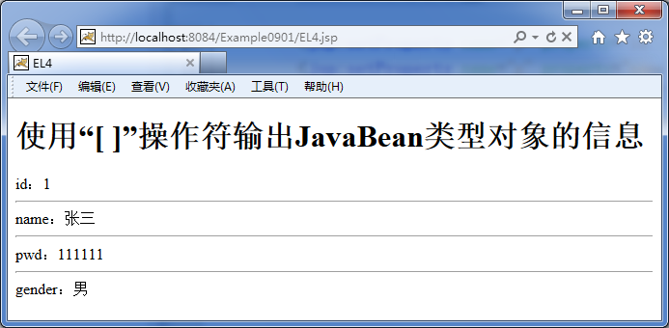
use"[]"Operator outputJavaBeanType object information

Slide 25
EL5.jsp
Is this the same as the array subscript?
<body>
<h1>use"[]"Operator outputs information about array type objects</h1>
<%
  String[] fruits = {"banana","apple","cantaloupe"};
  request.setAttribute("farray", fruits);
%>
  First1Growing fruits:${requestScope.farray[0]}<hr/>
  First2Growing fruits:${requestScope.farray[1]}<hr/>
  First3Growing fruits:${requestScope.farray["2"]}<hr/>
  All fruits?:${requestScope.farray}
</body>

Slide 26
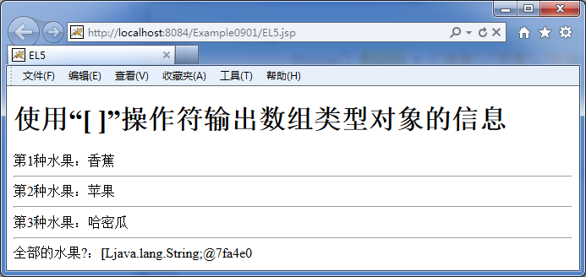
use"[]"Operator outputs information about array type objects

Slide 27
EL6.jsp
<body>
<h1>use"[]"Operator outputListType object information</h1>
<%
  List fruitList = new ArrayList();
  fruitList.add("banana");
  fruitList.add("apple");
  fruitList.add("cantaloupe");
  request.setAttribute("flist", fruitList);
%>
  First1Growing fruits:${requestScope.flist[0]}<hr/>
  First2Growing fruits:${requestScope.flist[1]}<hr/>
  First3Growing fruits:${requestScope.flist[2]}<hr/>
  All fruits:${requestScope.flist}
</body>

Slide 28
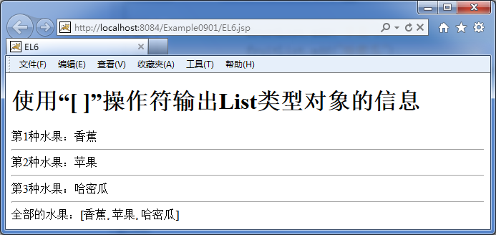
use"[]"Operator outputListType object information

Slide 29
9.1.6 ELHow to find objects in scope
4 Implied objects related to scope:
pageScope
requestScope
sessionScope
applicationScope
among thempageScopeversusJSPBuilt-in objects in the
pagepageContextSame range

Slide 30
EL7.jsp
<body>
<h1>ELHow to find objects in scope</h1>
<%
  pageContext.setAttribute("myKey", "pageScopeValue");
  request.setAttribute("myKey", "requestScopeValue");
  session.setAttribute("myKey", "sessionScopeValue");
  application.setAttribute("myKey", "applicationScopeValue");
%>
  OutputpageScopeMiddle key value"myKey"Corresponding object${pageScope.myKey}<hr/>
  OutputrequestScopeMiddle key value"myKey"Corresponding object${requestScope.myKey}<hr/>
  OutputsessionScopeMiddle key value"myKey"Corresponding object${sessionScope.myKey}<hr/>
  OutputapplicationMiddle key value"myKey"Corresponding object${applicationScope.myKey}<hr/>
  \${myKey}The output is this:${myKey}<hr/>
</body>

Slide 31
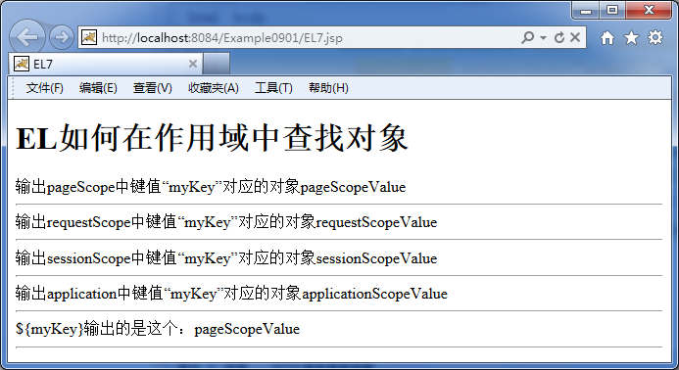
ELHow to find objects in scope

Slide 32
EL How to find objects in various scopes?
When the scope of the object is clearly specified, search in that scope;
When the scope of the object is not clearly specified,EL Will search for those satisfying the conditions in the descending order of scope key Value, output as soon as it is found.
Which is to press
pageScope—>requestScope—>sessionScope —>applicationScope
Search in order, and return the first object that meets the conditions.

Slide 33
9.1.7 useELrewriteExample0803
show.jsp
<body>
  ID:${p.id}<hr>
  NAME:${p.name}<hr>
  PWD:${p.pwd}<hr>
  GENDER:${p.gender}
</body>
</html>
Can it be usedELTo rewriteExample0804What? why?

Slide 34
9.2 JSTL(JSPStandard Tag Library)
9.2.1 JSTLOverview
JSTL(JavaServer Pages Standard Tag Library) Is calledJSPStandard tag library.
JSTLOriginally bysunThe company provides, package commonJSPThe core function of the application. It provides a single, standard set of tags. This standardized design allows the application to be easily deployed in any supportJSTLofJSPInside the container without custom development.

Slide 35
JSTL 5A tag library with different functions corresponds to different applications, such as:
core: Mainly responsible for the realization of core functions, including variable support, process control,URLManagement etc.
XML:XMLDocument related,XMLCore operations,XMLProcess control,XMLConversion
I18N: Mainly responsible for internationalization and formatting (formatting of date, time, and numbers)
SQL:Database operation related
Functions:inJSTLStandard defined inELFunction set, mainly for the operation of strings

Slide 36
9.2.2 JSTL Version and taglibs tatement
JSTLCurrently has3Versions,JSTL1.0,JSTL1.1,JSTL1.2.
inwebUsed in the projectJSTL, You need to download the relevantjarPackage, and then import it into the project.
Installed Tomcat If you don’t have to go online to download related jarFile, inTomcat Folder under the installation directory "\webapps\examples\WEB-INF\lib"Down, there are already relatedjar File, a total of2A——jstl.jar,standard.jar.

Slide 37
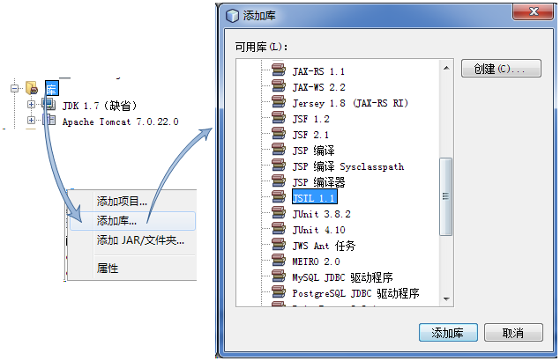

inNetBeansUsed inJSTL
NetBeansAdd inJSTLAfter the library file
NetBeansAdd inJSTLLibrary file

Slide 38
inJSPUse on the pageJSTLTags, in addition to adding library files, also need to be used on the pagetaglibThe instruction is declared, the syntax is as follows:
<%@taglib prefix="Label prefix"uri="LabelledURI" %>
For example, to use the core library, the code is:
<%@taglib prefix="c" uri="http://java.sun.com/jsp/jstl/core" %>
Tag library | prefix | uri
core | c | http://java.sun.com/jsp/jstl/core
XML | x | http://java.sun.com/jsp/jstl/xml
I18N | fmt | http://java.sun.com/jsp/jstl/fmt
SQL | sql | http://java.sun.com/jsp/jstl/sql
Functions | fn | http://java.sun.com/jsp/jstl/functions

Slide 39
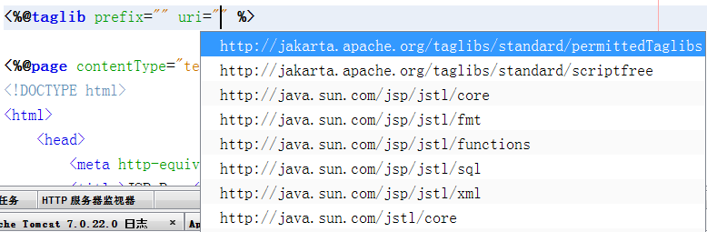
NetBeans IDEFill in by grammar prompt shortcut keys inuri

Slide 40
Goal: learnJSTLUse of core tag library
Construction name:Example0902
Files used:
file name | Description
forEach.jsp | Manually createdJSPFiles, learning<forEach></forEach>Use of labels.
forTokens.jsp | Manually createdJSPFiles, learning<forTokens></forTokens>Use of labels.
if.jsp | Manually createdJSPFiles, learning<if></if>Use of labels.
choose.jsp | Manually createdJSPFiles, learning<choose></choose>Use of labels.
chooseAndForEach.jsp | Manually createdJSPFile, learning will<choose>Label and<forEach></forEach>The labels are used in combination.

Slide 41
9.2.3 JSTLCore tag library (labels that control loops)
JSTLThere are two groups of tags that control loops in the core tag library
<c:forEach> </c:forEach>
<c:forTokens> </c:forTokens>

Slide 42
<c:forEach> </c:forEach>
<h3>1useforEach(begin,end,step) Output10AHello!</h3>
<c:forEach begin="1" end="10" step="1" >
  Hello!
</c:forEach>

Slide 43
<h3>2useforEach(var,begin,end,step) Output1-10Integer between</h3>
<c:forEach var="output" begin="1" end="10" step="1" >
  ${output}
</c:forEach>
<h3>3useforEach(var,begin,end,step) Output1-10Even number between</h3>
<c:forEach var="output" begin="2" end="10" step="2">
${output}
</c:forEach>

Slide 44
<%
  String[] fruits = {"banana", "apple", "cantaloupe"};
  request.setAttribute("myfruits", fruits);
%>
<h3>4useforEach(var,items) The elements in the output collection</h3>
<c:forEach var="output" items="${myfruits}">
  ${output}
</c:forEach>

Slide 45
<h3>5useforEach(var,items,varStatus) The elements in the output collection</h3>
<c:forEach var="output" items="${myfruits}" varStatus="status">
  First${status.count}Elements ${output} <br/>
</c:forEach>

Slide 46
<c:forEach></c:forEach>Attributes and functions of tags
Attributes | description
var | The name of the variable representing the loop object, if it existsitemsAttribute, it represents the variable name of the object in the loop collection (optional)
items | Collection to loop (optional)
varStatus | Variables showing loop status (optional)
begin | Start condition (optional)
end | End condition (optional)
step | The step length of the loop, the default is1(Optional)

Slide 47
<c:forTokens> </c:forTokens>
<c:forTokens></c:forTokens>Similar tojava.util.StringTokenizerClass, which provides a convenient way to manipulate strings.
For example: there is a string of "eat, sleep, peas" and the separator in the middle is ",", now we want to retrieve "eat", "sleep" and "play peas", then we can use
<c:forTokens></c:forTokens>.

Slide 48
<h3>Meaningless separation (items,delims)</h3>
<c:forTokens items="eat,go to bed,Beaten beans" delims=",">
  Hello!
</c:forTokens>
Where the attributesitemsRepresents the object to be
recycled,delims Represents the separator.
Output three "Hello!"

Slide 49
<h3>Output separated elements (items,delims,var)</h3>
<c:forTokens items="eat,go to bed,Beaten beans"delims="," var="s">
  ${s}
</c:forTokens>
Output "eat, sleep, and peas"

Slide 50
<h3>Output some elements of the separated elements<br/>(items,delims,var,begin,end,step)</h3>
<c:forTokens items="eat,go to bed,Beaten beans"delims="," var="s" begin="1" end="2" step="1">
  ${s}
</c:forTokens>
Please be aware ofbeginThe attribute is deliberately set to1, The code will output "sleeping and beating beans" instead of "eating and sleeping", indicating that the subscript is from0Started.

Slide 51
9.2.4 JSTL Core tag library (labels that control program flow)
JSTLThere are two sets of tags in the core tag library that control program flow
<c:if> </c:if>
<c:choose> </c:choose>

Slide 52
<c:if></c:if>
<c:if></c:if>The label provides a conditional judgment function, and the judgment condition depends on the attributetest, In addition<c:if></c:if>There are two forms, one with a label body and one without
With label body<c:if></c:if>
<h3>1The simplest condition judgment and output (test)</h3>
<c:if test="${1<2}">
  Condition is true
</c:if>
Output string "condition is true"

Slide 53
Without label body<c:if></c:if>
<h3>2Assign the judgment result to a variable and store the variable in the default scope (test,var)</h3>
<c:if test="${1<2}" var="output"/>
${pageScope.output}
In addition to saving the result of the condition on the current page (page), can also be saved inrequest,session,applicationIn, you need to passscopeThe attribute indicates the scope.
<h3>3Assign the judgment result to a variable and store the variable in a specific scope (test,var,scope)</h3>
<c:if test="${2<2}" var="output" scope="request"/>
${requestScope.output}

Slide 54
<c:choose></c:choose>
JSTLNo form is provided inif-elseThis form of label group, if you want to achieve a similar effect, you can pass<c:choose></c:choose>label.<c:choose></c:choose>A label is actually a set of labels, including
  <c:choose> </c:choose>
  <c:when> </c:when>
  <c:otherwise> </c:otherwise>
Three labels, effects and switch statements(switch-case)similar.

Slide 55
choose.jsp(Converted the percentile system to5Points system)
<body>
  <%
    request.setAttribute("score", 45);
  %>
  <c:choose>
    <c:when test="${score>=90}">excellent</c:when>
    <c:when test="${score>=80}">good</c:when>
    <c:when test="${score>=70}">in</c:when>
    <c:when test="${score>=60}">Pass</c:when>
    <c:otherwise>failed</c:otherwise>
  </c:choose>
</body>

Slide 56
9.2.5 JSTLCore tag library (<c:forEach>,<c:choose>Combined)
<h3>1Judge and output the elements in the array</h3>
<%
  String[] fruits = {"banana", "apple", "cantaloupe"};
  request.setAttribute("myfruits", fruits);
%>
<c:choose>
  <c:when test="${empty myfruits}">
    There is no data that meets the conditions!
  </c:when>
  <c:otherwise>
    <c:forEach var="fa" items="${myfruits}">
      ${fa}
    </c:forEach>
  </c:otherwise>
</c:choose>

Slide 57
<h3>2Judge and outputListElements in</h3>
<%
  List fruitList = new ArrayList();
  fruitList.add("Mango");
  fruitList.add("Strawberry");
  fruitList.add("Peach");
  request.setAttribute("flist", fruitList);
%>
<c:choose>
  <c:when test="${empty flist}">
    There is no data that meets the conditions!
  </c:when>
  <c:otherwise>
    <c:forEach var="fb" items="${flist}">
      ${fb}
    </c:forEach>
  </c:otherwise>
</c:choose>

Slide 58
9.3 useJSTL,ELrewriteExample0804
file name | Description
index.jsp | It is a file automatically created when the project is created. Used to submitPERSONGender information, submitted toQueryServlet.
Person.java | Manually createdJavaBean, EncapsulatedPersonInformation, there areid,name,pwd,gender4Fields and corresponding access control methods
QueryServlet | Manually createdServlet, WhereServletQuery all the information corresponding to the gender in the, and jump according to the query result.
show.jsp | Manually createdJSPFile, used to display the queried information.

Slide 59
9.3.1 First1Rewrite
<%
  List<Person> list = (ArrayList<Person>) request.getAttribute("plist");
  for (Person p: list) {
%>
<tr>
  <td><%=p.getId()%></td>
  <td><%=p.getName()%></td>
  <td><%=p.getPwd()%></td>
  <td><%=p.getGender()%></td></tr>
<%
  }
%>
show.jsp(throughJSTL,ELCorresponding fragment after rewriting)
<c:forEach var="p" items="${plist}">
  <tr>
    <td>${p.id}</td>
    <td>${p.name}</td>
    <td>${p.pwd}</td>
    <td>${p.gender}</td>
  </tr>
</c:forEach>

Slide 60
9.3.2 First2Rewrite
QueryServletCode snippet
rs = prst.executeQuery();
while (rs.next()) {
  Person person = new Person();
  person.setId(rs.getInt("id"));
  person.setName(rs.getString("name"));
  person.setPwd(rs.getString("pwd"));
  person.setGender(rs.getString("gender"));
  plist.add(person);
}
if (plist.isEmpty()) {
  out.print("The person does not exist!");
} else {
  request.setAttribute("plist", plist);
  request.getRequestDispatcher("show.jsp").forward(request, response);
}

Slide 61
QueryServlet.java(after editedQueryServletCode snippets)
rs = prst.executeQuery();
while (rs.next()) {
  Person person = new Person();
  person.setId(rs.getInt("id"));
  person.setName(rs.getString("name"));
  person.setPwd(rs.getString("pwd"));
  person.setGender(rs.getString("gender"));
  plist.add(person);
}
request.setAttribute("plist", plist);
request.getRequestDispatcher("show.jsp").forward(request, response);

Slide 62
show.jsp
<c:choose>
  <c:when test="${empty plist}">
    There is no data that meets the conditions!
  </c:when>
  <c:otherwise>
    <table border="1" align="center">
    <tr>
    <th>student ID</th>
    <th>Name</th>
    <th>password</th>
    <th>gender</th>
    </tr>
    <c:forEach var="p" items="${plist}">
      <tr>
      <td>${p.id}</td>
      <td>${p.name}</td>
      <td>${p.pwd}</td>
      <td>${p.gender}</td>
      </tr>
    </c:forEach>
    </table>
  </c:otherwise>
</c:choose>

Slide 63
Homework problems
[1].Glossary:EL,JSTL
[2].ELHow many hidden objects are related to the scope in? What are they?
[3].Use in web pagesJSTL, What settings need to be made in advance?
[4].If you want to use it in the pageJSTLCore library,taglibHow should it be set? Combined with the code description. .

